Slide 1
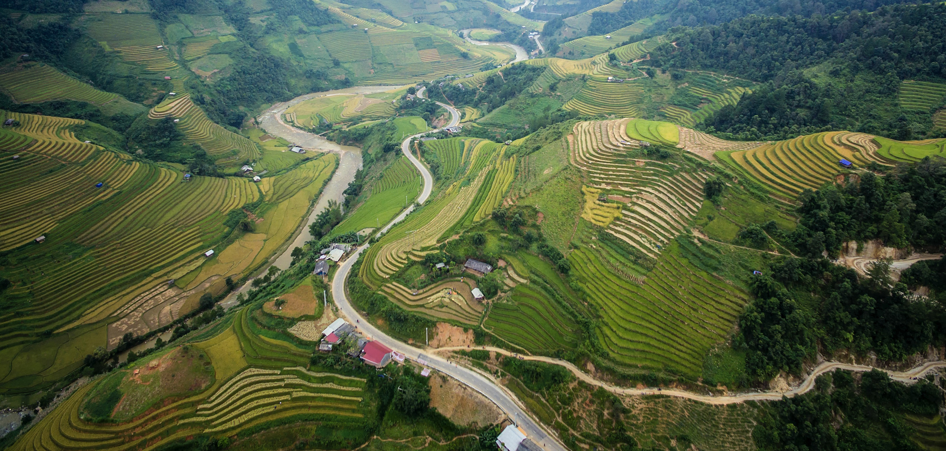
Designing a Tool to Help Farmers Utilize NASA Data for Water Management

Slide 2
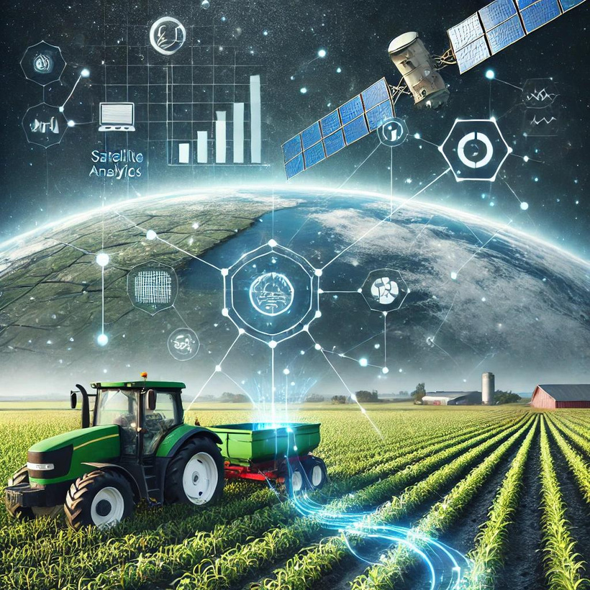
Challenge :
Leveraging Earth Observation Data for Informed Agricultural Decision-Making
About the Challenge

Slide 3
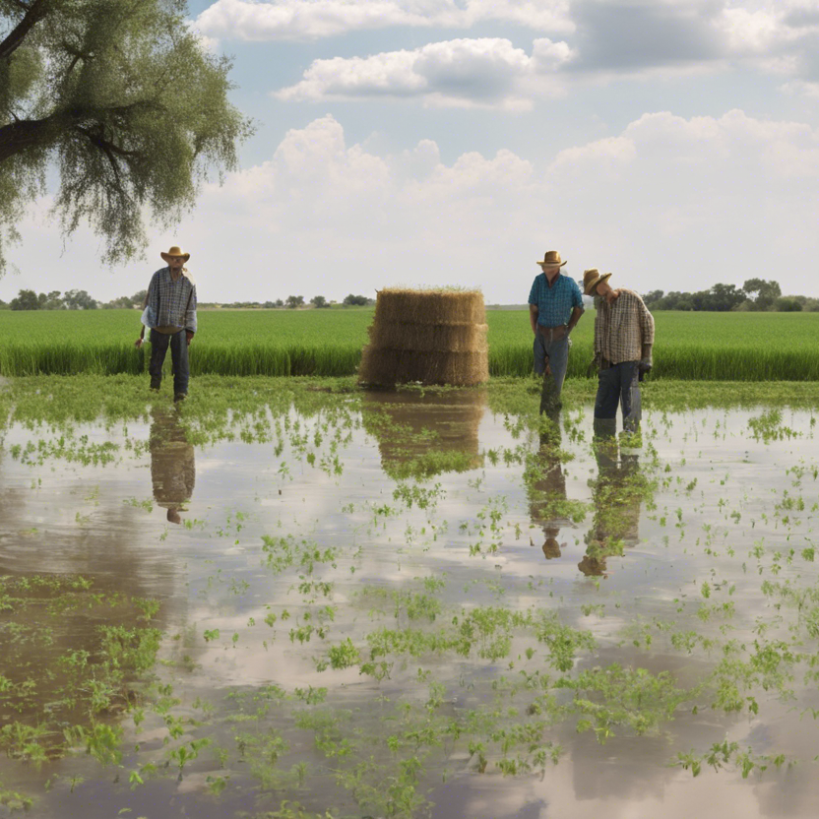
Challenges Faced by Farmers
01
Unpredictable Weather:
02
Pests and Diseases:
Farmers may experience droughts or floods, sometimes within the same season.
These negatively affect crop health and farmer profits.
Impact on Food Security:
Difficulty in Accessing Critical Data:
03
04
Crop failures lead to food shortages.
Farmers need accurate data to improve agricultural practices.

Slide 4
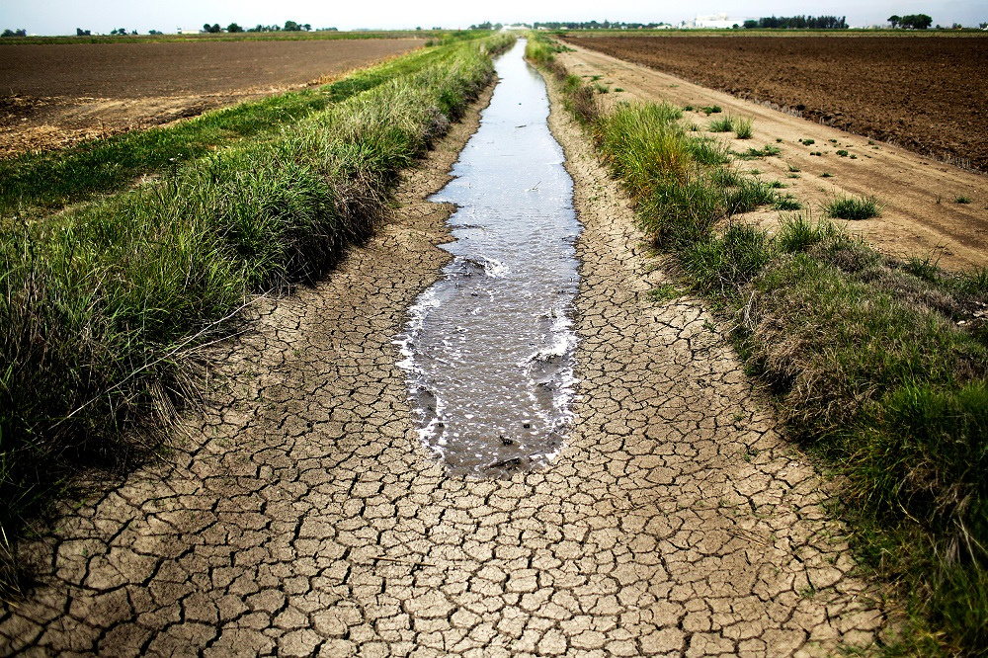
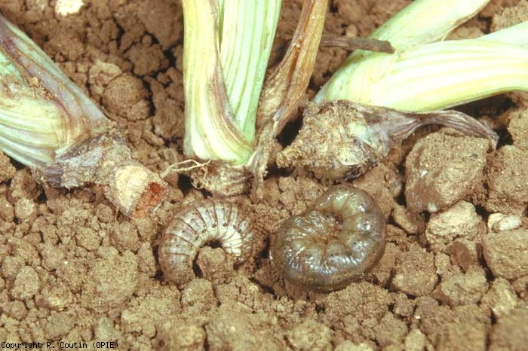
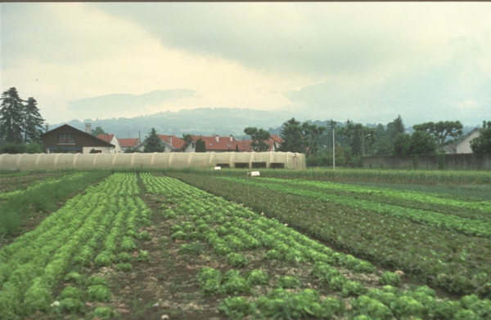
Example:

Slide 5
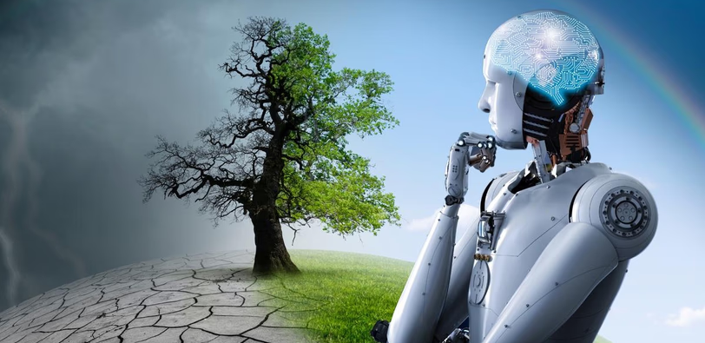
The Proposed Solution
Designing a Tool to Empower Farmers to:
Utilize Data to prevent water crises such as droughts and floods.
Easily Access NASA Data related to water and weather.
Analyze Data for better decision-making.

Slide 6
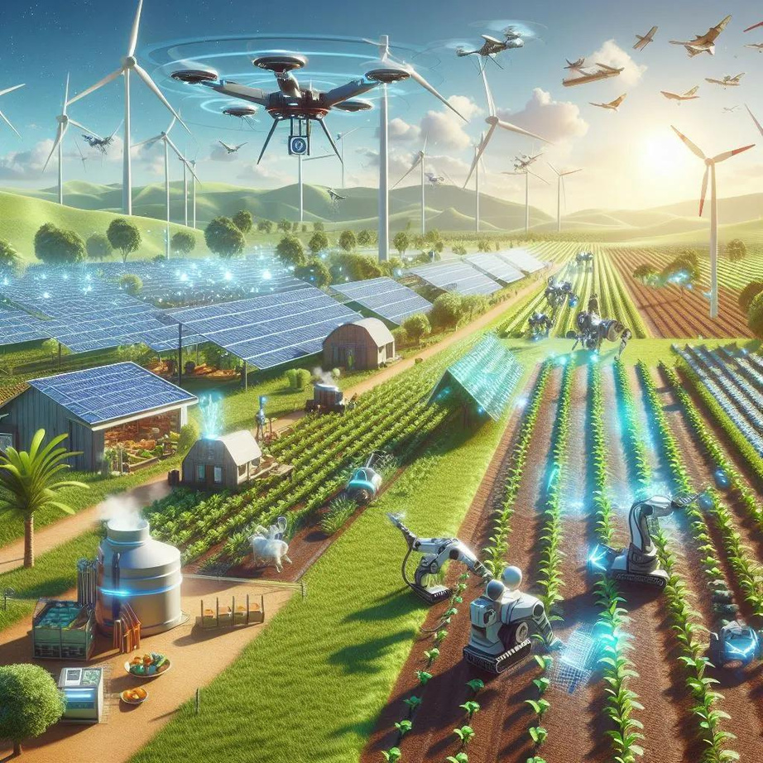
Key Features of the Tool
01
Data Access :
Access to satellite data (soil moisture, rainfall, drought indices).
Integration with local and historical weather data.
02
User Interface :
Easy-to-use dashboard for data visualization and forecasts.
Interactive geographic visualization using maps.

Slide 7
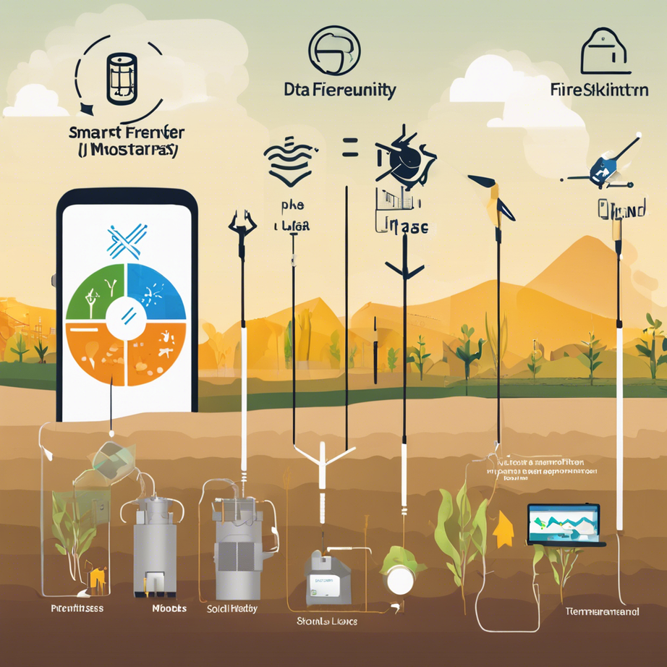
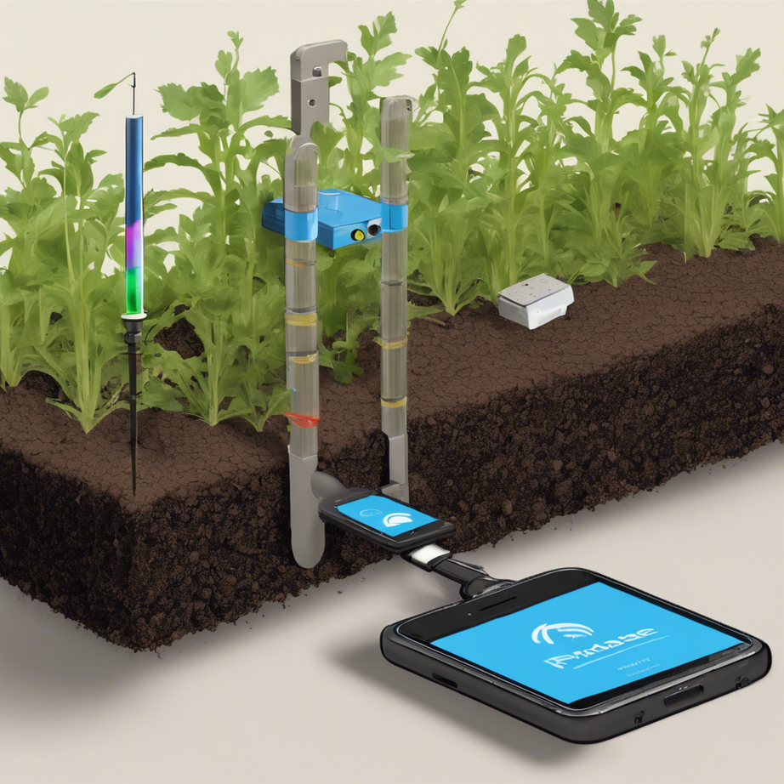

Implementation

Slide 8
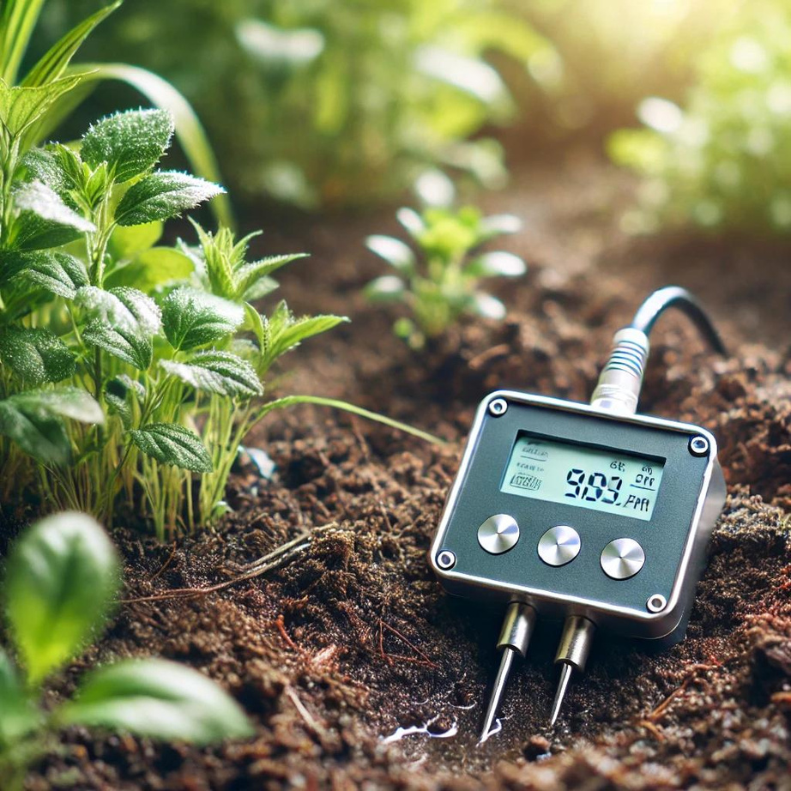
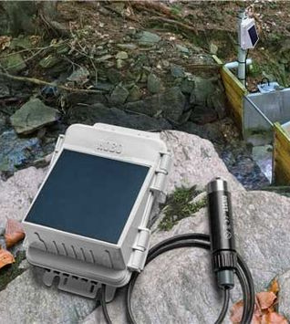
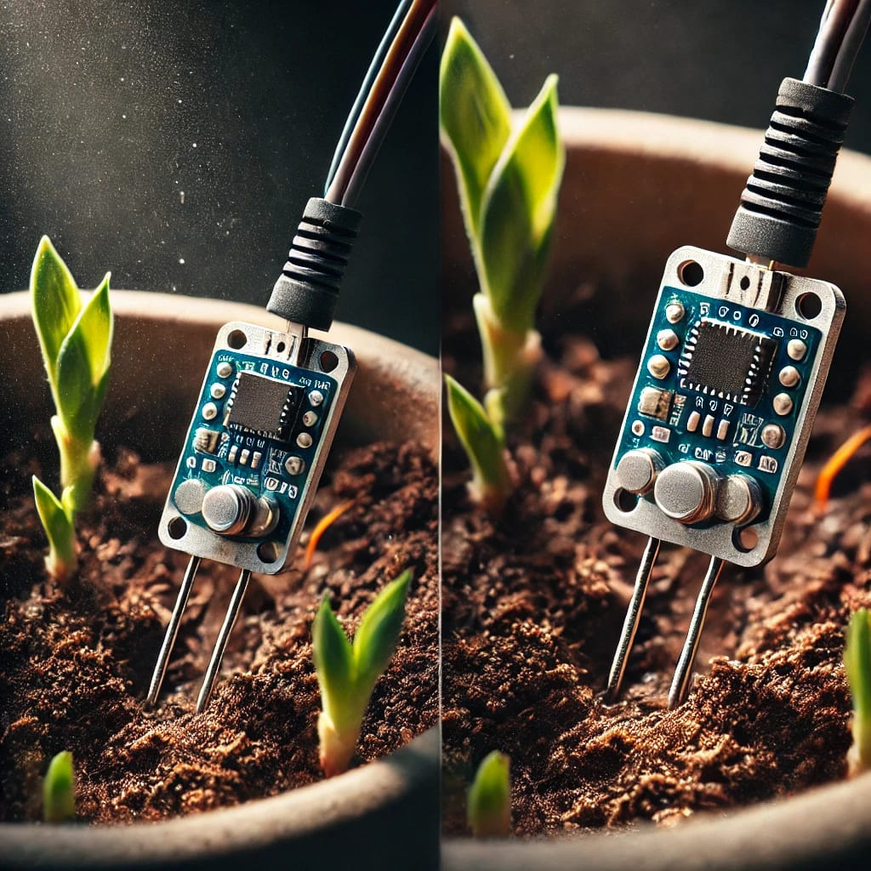
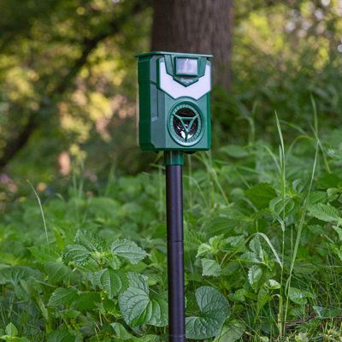
Overview of the Tool
01
Purpose
To empower farmers with accurate data for effective water management and crop monitoring.
02
Components
Four high-precision sensors to monitor soil moisture, water levels, soil quality, and pest detection.

Slide 9
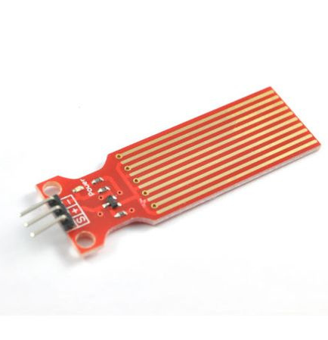
Water Level Sensor
Description :
Uses ultrasonic technology to measure water levels in tanks or detect floods
Advantages:
High accuracy in water level measurement.
Suitable for detecting excess water or flood conditions.
Usage:
Integrates with monitoring systems to predict floods

Slide 10
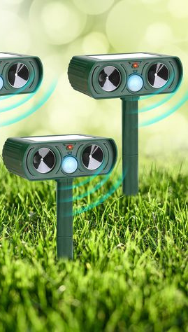
Pest Detection Sensor
Description :
Utilizes motion or sound detection to identify pests
Advantages:
Can be combined with soil sensors to provide data on potential pest issues.
Usage:
Suitable for smart farming applications

Slide 11
Soil Moisture Sensor
Description :
Measures soil moisture quickly and effectively using soil capacitance
Advantages:
Waterproof for improved measurement accuracy.
More precise than traditional analog sensors.
Usage:
Ideal for smart farming, operating long-term without degradation

Slide 12
Soil Quality Sensor
Description :
Measures various factors including soil moisture, temperature, and pH levels
Advantages:
Provides a comprehensive picture of soil quality.
Helps determine if soil is suitable for farming.
Usage:
Useful for improving agricultural productivity

Slide 13
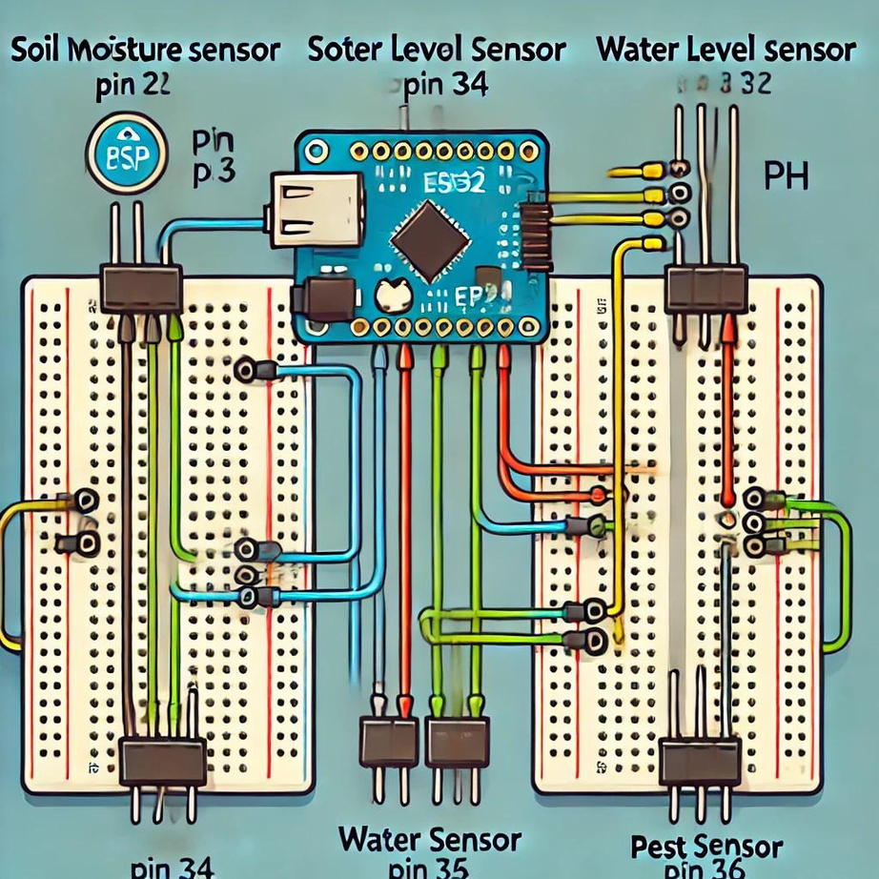
Connection to ESP32 and practical application
Soil Moisture Sensor
VCC to 3.3V, GND to GND, Data to Pin 34.
Water Level Sensor
VCC to 3.3V, GND to GND, Data to Pin 35.
pH Sensor
VCC to 3.3V, GND to GND, Data to Pin 32.
Pest Sensor
VCC to 3.3V, GND to GND, Data to Pin 36.

Slide 14
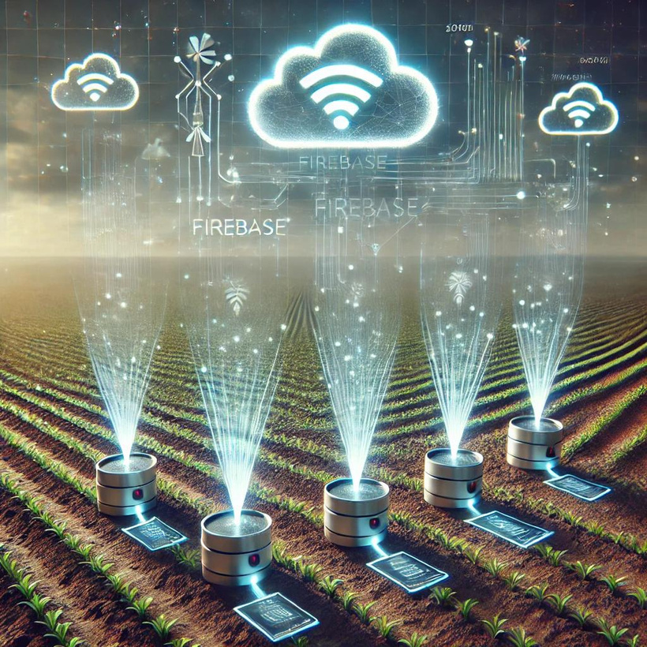
Connecting ESP32 with Firebase
Purpose:
01
Firebase is used to store and monitor real-time data from the sensors (e.g., soil moisture, water level) remotely.
Why Firebase?
02
Easy to visualize sensor readings.
Allows sending suggested solutions based on sensor data.
Enables real-time updates for quick response.
How?
03
Connect to WiFi.
Initialize Firebase using Firebase.begin.
Send data to Firebase paths using Firebase.setString

Slide 15
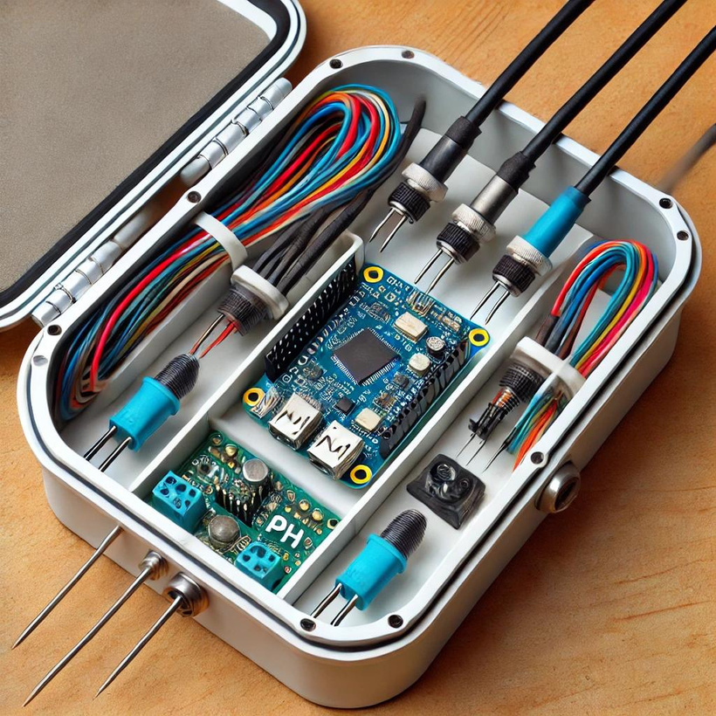
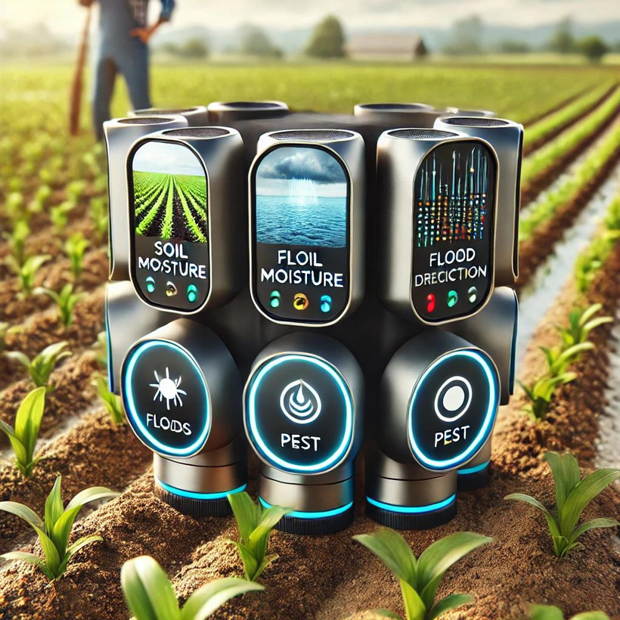
Completion of the Tool
The agricultural monitoring device is now fully completed and operational.
The four integrated sensors (Soil Moisture, Water Level, pH, and Pest Detection) are connected to the ESP32 microcontroller, providing real-time data to help farmers monitor environmental conditions.
Check the code on GitHub

Slide 16
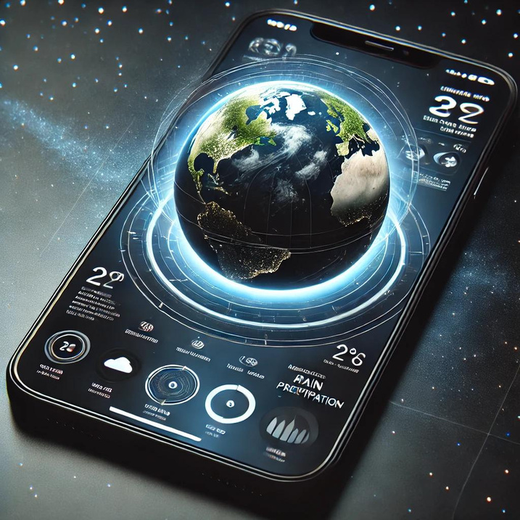
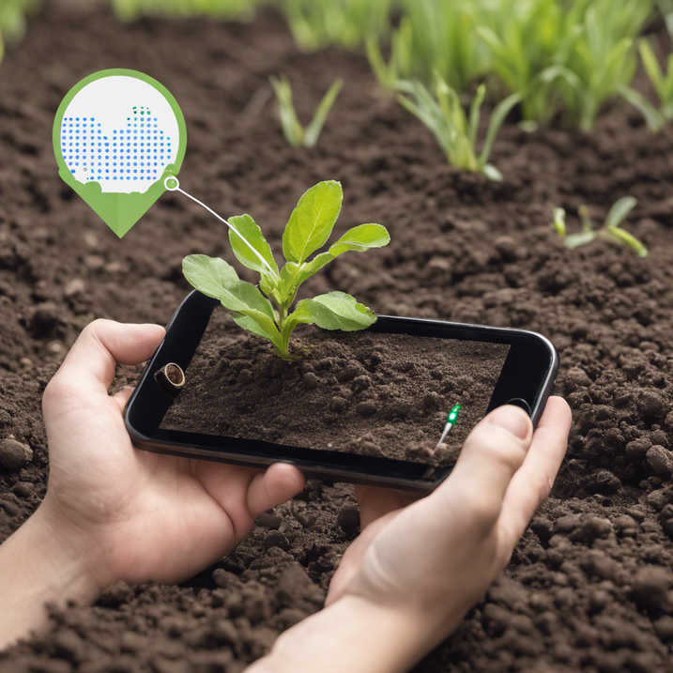
User Interface Overview
The app receives real-time sensor readings from the agricultural device.
User-friendly interface designed to help farmers make informed decisions.
Provides various display options for data analysis and climate forecasts.

Slide 17
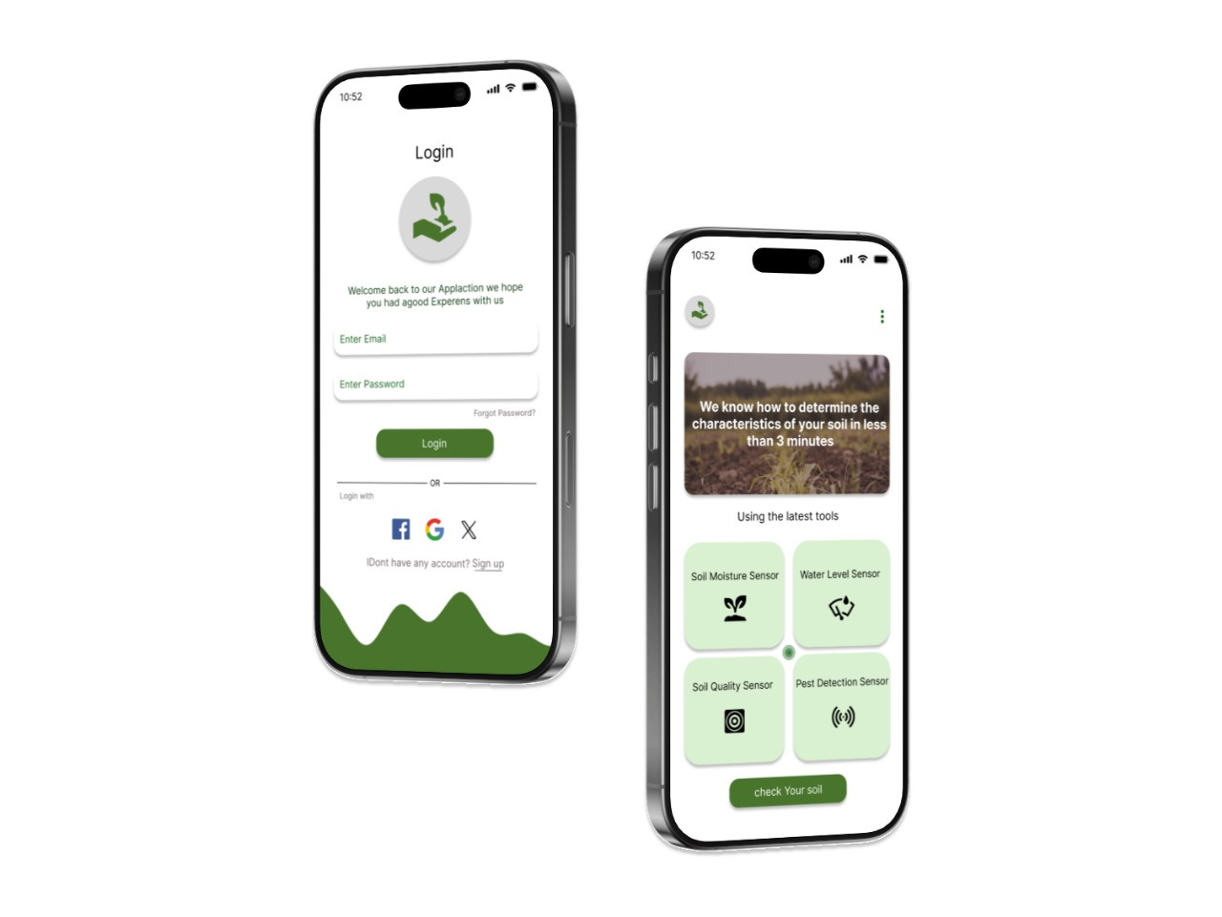
Registration Page
Users sign up securely with simple data input.
After registration, they are directed to the control panel.
The app offers two main choices: View Map or Test Soil.

Slide 18
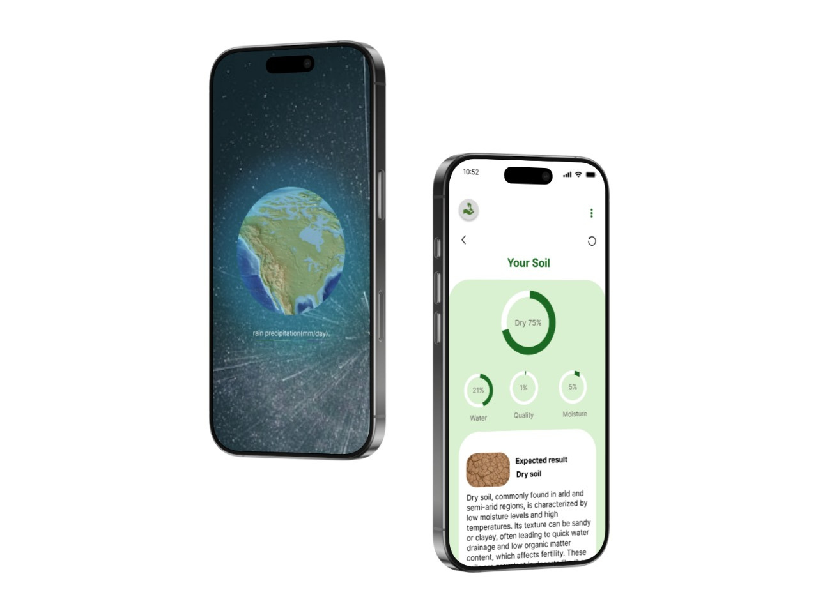
Control Panel
The control panel displays all available options for the user.
Farmers can select View Map for climate forecasts.
Alternatively, they can choose Test Soil to receive sensor data.

Slide 19
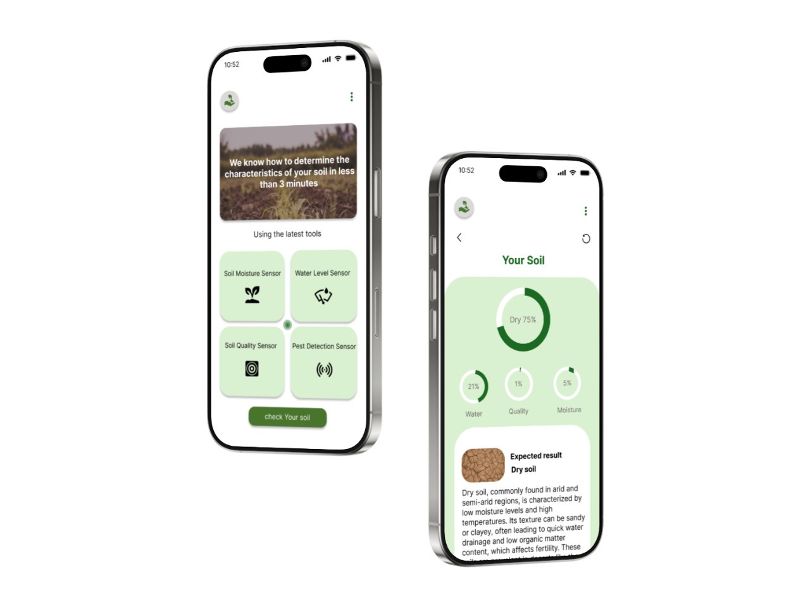
Readings Page
Displays real-time data on soil moisture, water level, pH, and pest detection.
Users can closely monitor the data to make better farming decisions.
Data updates constantly to provide an accurate view of soil conditions.

Slide 20
Map Page
The map shows climate forecasts for the farming area.
Forecasts include risks like floods or droughts.
Helps farmers plan ahead and mitigate potential risks.

Slide 21
Resources
IMERG for rainfall data
SMAP to monitor soil conditions
ASTER & LANDSAT to drought data

Slide 22
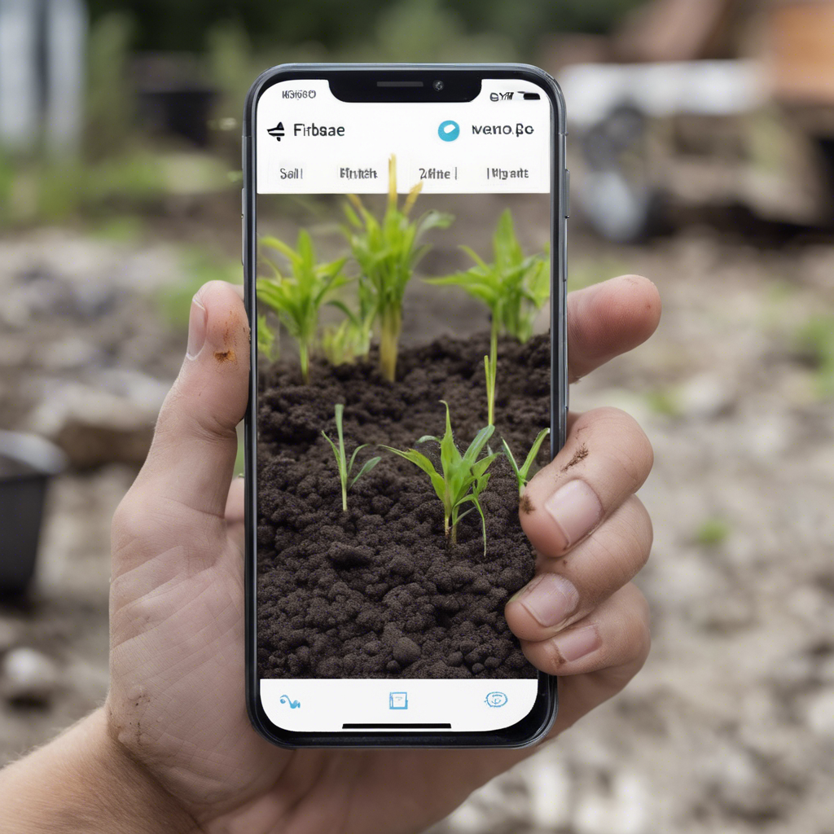

Application Design Completion
The mobile application for farmers is now fully designed and ready.
It includes real-time sensor data readings, weather forecasts, and interactive maps
User-friendly interface ensuring smooth interaction for farmers' daily use.
Farmers can make informed decisions with ease using data-driven insights.
View the UI Design on Figma

Slide 23

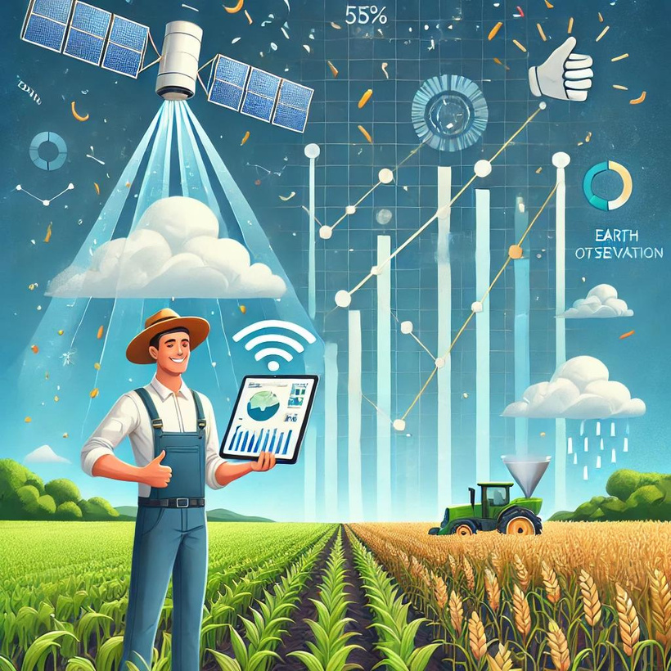
Benefits of the Tool
Help farmers make data-driven decisions.
Improve water usage efficiency and reduce the impact of climate change.
Increase agricultural productivity and food security.

Slide 24
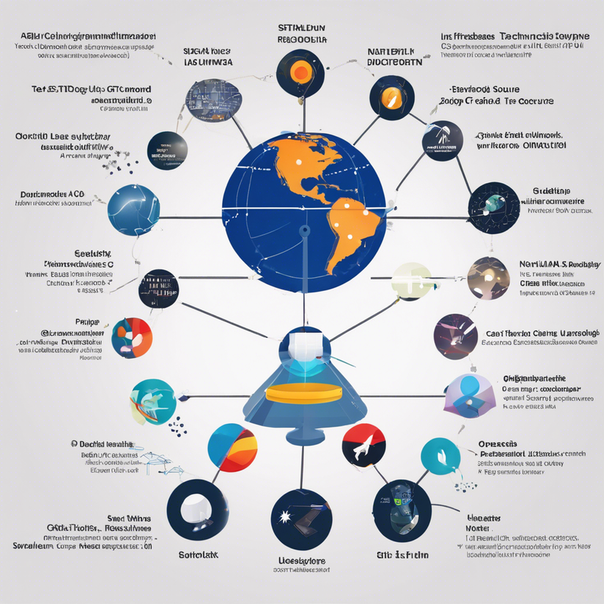
Technology Stack
Flutter
IOT & AI
Databases: Firebase
Data Sources: NASA Earthdata APIs, OpenWeather.

Slide 25
OUR TEAM
Team Name
NewLine
Team Members
Mohamed Ahmed Salama
Ahmed Hassan Gamal
Mostafa Mohamed Salah Al-Din
Islam Salah Al-Sayed
Mahmoud Hany Attia
Mustafa Al-Sayed Farghaly

